Slide 1
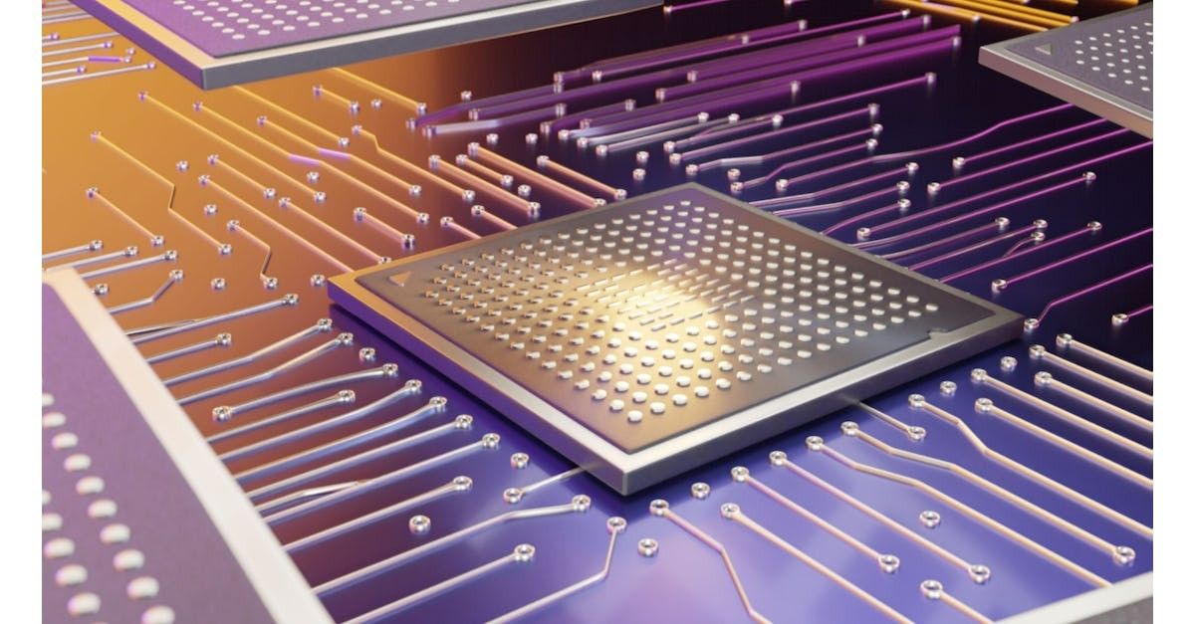
Revolutionizing Semiconductor Packaging
The Role of Hydrogen Plasma in Advanced IC Stacking
Presenter : Jonathan Reggie Ebenezer
ASU ID: 1231742293
1

Slide 2
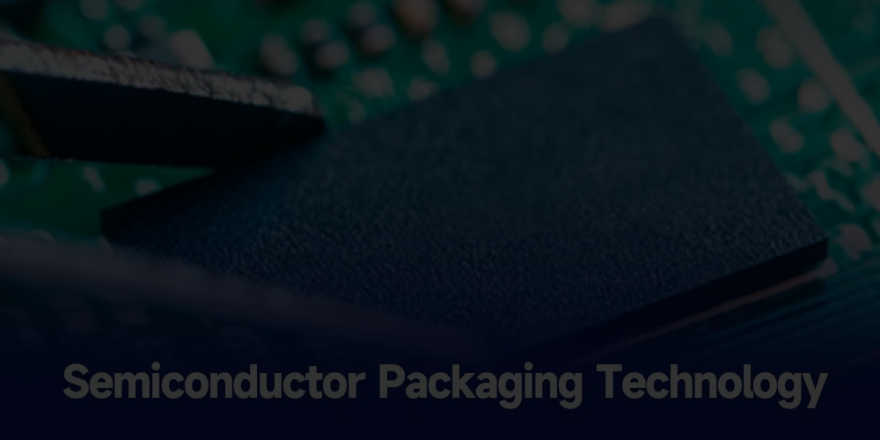
Outline
Introduction
The Role and Challenge of Flip-Chip Technology
Hydrogen Plasma for Oxide Removal
Atmospheric Pressure Plasma Technology
Hydrogen Plasma Equipment and Operation
Applications for Micro-Bump Bonding
Applications for Hybrid Bonding
Case Study: Oxide Reduction with Plasma (Copper Oxide Removal)
Results from Atmospheric Plasma Treatment
Scalability and Efficiency of Hydrogen Plasma
Environmental Benefits of Hydrogen Plasma
Conclusion
References
2

Slide 3
Introduction
Semiconductor devices are demanding higher performance, power efficiency, and miniaturization, which requires advancements in IC stacking and packaging.
Traditional methods using fluxes for bonding struggle with oxide layer contamination that can weaken the bonds, hindering device reliability and performance.
Hydrogen plasma is increasingly critical in semiconductor packaging for high-performance demands like AI, cloud computing, and 5G​
The need for advanced IC stacking drives research into cleaner, more reliable bonding methods to maintain device compactness and efficiency
3

Slide 4
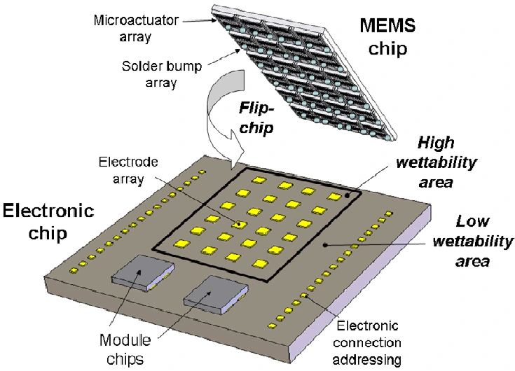
The Role and Challenge of Flip-Chip Technology
Figure(1): Flip Chip Technology
Flip-chip technology connects chips by using metal bumps.
However, these connections are sensitive to oxide contamination on the metal surfaces.
Contaminants impact the bond strength, which is especially problematic in high-performance applications like AI and 5G.
So an atmospheric pressure hydrogen plasma can be employed to remove the oxide formation under different conditions based on the interconnects used.
Figure(1):https://techovedas.com/what-is-flip-chip-technology/
4

Slide 5
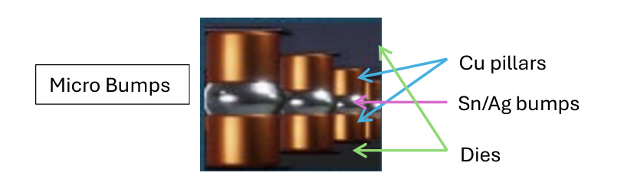
Hydrogen Plasma for Oxide Removal
Figure(2): Micro-bump structure after thermocompression bonding[1]
Hydrogen plasma provides a flux-free, clean oxide removal method, allowing for more reliable connections. It reacts with oxide layers, turning them into vapor, which is then removed without leaving residue.
This method outperforms traditional fluxes by reducing contamination while avoiding residue buildup between closely spaced micro-bumps
The plasma process must occur within the bonding environment to prevent oxide reformation on metal surfaces​
Reference: [1]In Situ Hydrogen Plasma – A New Paradigm for Advanced Packaging (Author:Dr.Robert F. Hicks)
5

Slide 6
Atmospheric Pressure Plasma Technology
This method of plasma cleaning operates at atmospheric pressure, which simplifies equipment requirements, reduces processing costs, and minimizes the risk of damage (mainly heat damage) to sensitive semiconductor components.
It can run at relatively low temperatures and avoids the need for vacuum environments, making it more practical for high-volume manufacturing
The technology avoids particle generation, essential for high-density interconnects in semiconductor devices​.
6

Slide 7
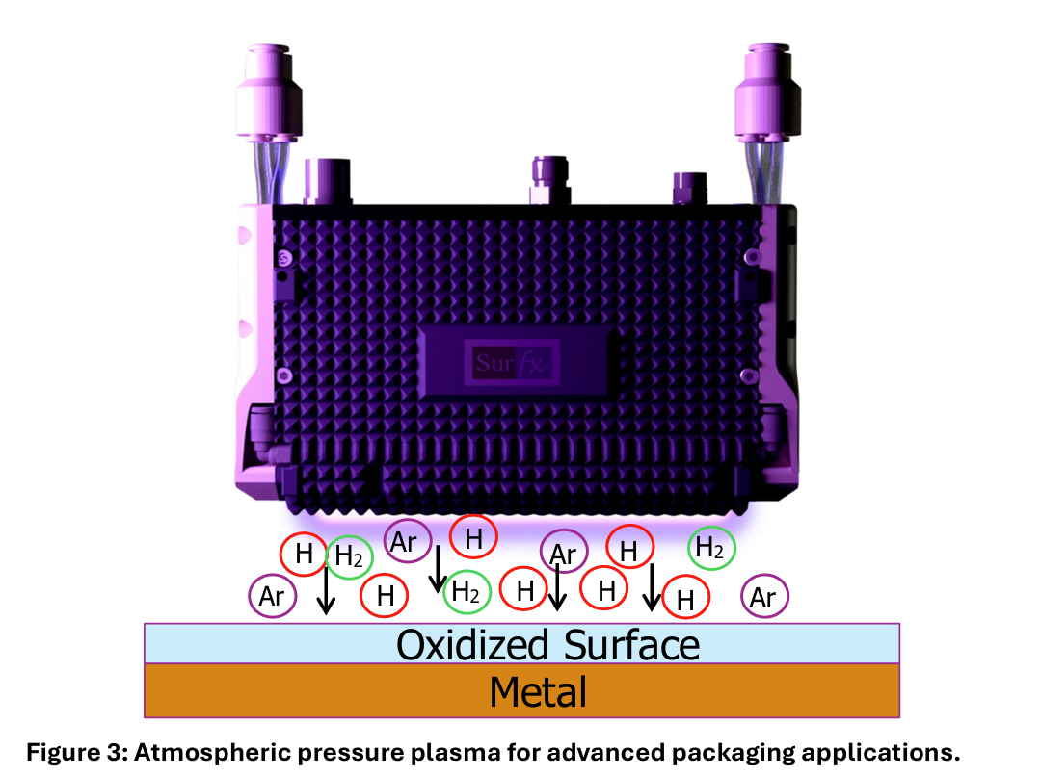
Hydrogen Plasma Equipment and Operation
Figure(3): Atmosphere pressure plasma for advanced packaging applications[1]
Hydrogen plasma systems use a controlled argon-hydrogen mix, allowing low-energy plasma generation that safely interacts with chip surfaces without heating them excessively.
Applications include improving wire bonding, enhancing die attachment, and supporting wafer bump reflow, essential for dense IC stacking
Reference: [1]In Situ Hydrogen Plasma – A New Paradigm for Advanced Packaging (Author:Dr.Robert F. Hicks)
7

Slide 8
Applications for Micro-Bump Bonding
Flip-Chip Packaging: Hydrogen plasma effectively cleans micro-bump surfaces in flip-chip designs, improving bond reliability in dense 2D arrays.
Increased Reliability: Ensures clean, oxide-free interconnects essential for high-speed, low-resistance connections in memory and processor devices​.
Industry Relevance: Critical for applications demanding high I/O density and gigahertz-level communication speeds, like AI and data centers
8

Slide 9
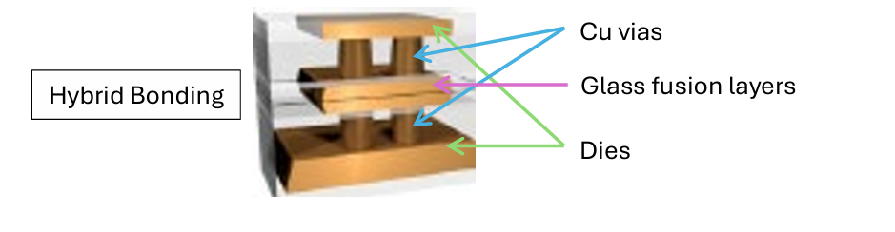
Applications for Hybrid Bonding
Figure(4): Hybrid bond structure[1]
Clean Surface Preparation: Removes organic contaminants from dielectric surfaces, essential for effective glass-to-glass and copper-to-copper bonding in hybrid bonding​
Improved Bond Strength: Plasma cleaning maximizes Si-OH groups on surfaces, enhancing bond formation during the annealing phase​.
Application Versatility: Supports die-to-die, die-to-wafer, and wafer-to-wafer configurations in IC stacking
Reference: [1]In Situ Hydrogen Plasma – A New Paradigm for Advanced Packaging (Author:Dr.Robert F. Hicks)
9

Slide 10
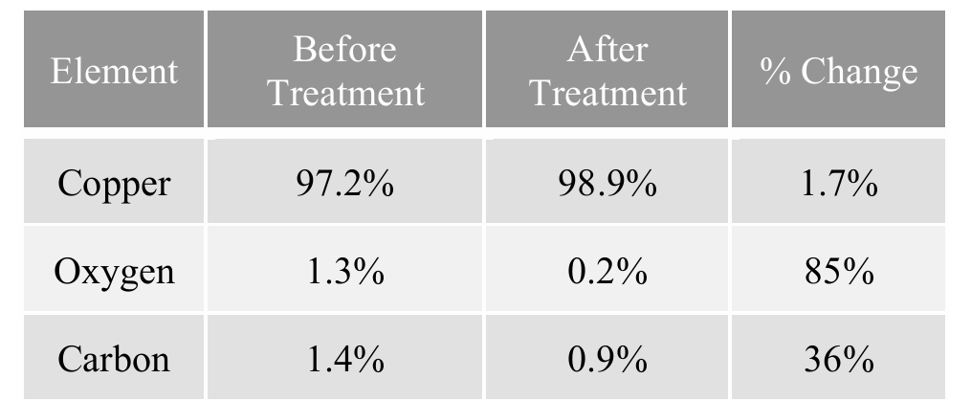
Case Study: Oxide Reduction with Plasma (Copper Oxide Removal)
Table: Results from the SEM-EDS analysis of Cu Samples treated with the chamber results[2]
Experimental Setup: Plasma with 95% nitrogen and 5% hydrogen reduced copper oxide layers, confirming oxide removal efficiency in atmospheric conditions.
Results: Significant oxide reduction observed with SEM-EDS analysis, achieving nearly 85% oxygen reduction without vacuum​.
Scalability: High throughput for in-line industrial applications, processing surfaces at up to 150 mm/s without temperature risks
Reference: [1]Metal Oxide Removal Using Atmospheric Pressure Plasma Technology for Electronic Applications(Author: Daphne Pappas, Andrew Sy, Ryan Robinson, and Richard Burke Plasmatreat USA, Inc)
10

Slide 11
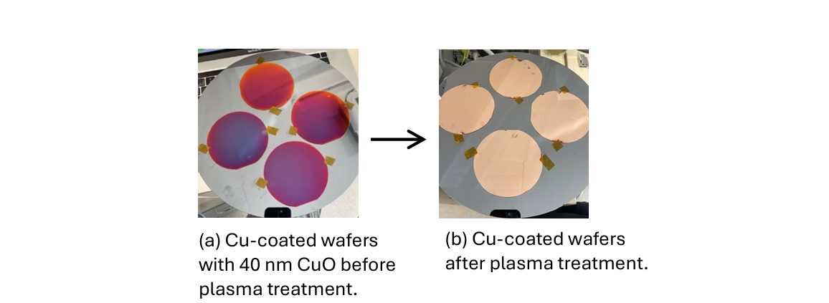
Results from Atmospheric Plasma Treatment
Figure(5) : [1]Copper-coated silicon wafers with thick oxide layer before treatment and no oxide layer after treatment with atmospheric pressure argon and hydrogen plasma.
Oxide and Residue Removal: Studies confirm hydrogen plasma removes both metal oxides and organic contaminants, increasing bond integrity​[2]
Enhanced Surface Energy: Plasma-treated surfaces showed improved wettability and bonding efficiency, validated by SEM-EDS​[1]
Experimental Validation: Data on copper oxide and organic residue reduction highlights hydrogen plasma’s effectiveness in semiconductor application
Reference: [1]Metal Oxide Removal Using Atmospheric Pressure Plasma Technology for Electronic Applications(Author: Daphne Pappas, Andrew Sy, Ryan Robinson, and Richard Burke Plasmatreat USA, Inc)
[2]In Situ Hydrogen Plasma – A New Paradigm for Advanced Packaging (Author:Dr.Robert F. Hicks)
11

Slide 12
Scalability and Efficiency of Hydrogen Plasma
In-Line Process Capability: Easily integrated into manufacturing lines, hydrogen plasma supports high-volume production​.
Rapid Processing: Enables high-speed substrate cleaning, making it cost-effective for large-scale semiconductor packaging​.
Uniform Application: Consistent oxide and residue removal across wafer surfaces with robotic control for precision
12

Slide 13
Environmental Benefits of Hydrogen Plasma
Eco-Friendly Solution: Eliminates the need for hazardous chemicals traditionally used in oxide removal, reducing environmental impact​.
Energy Efficiency: Operates at low temperatures and pressures, consuming less energy and lowering overall production costs.
Reduced Emissions: By removing oxides without chemical by-products, hydrogen plasma contributes to cleaner semiconductor manufacturing processes​
13

Slide 14
Conclusion
Hydrogen plasma is shown to enable high-density interconnections critical for compact, high-performance devices.
By providing a clean, scalable, and environmentally-friendly alternative, it supports the next generation of semiconductor devices while setting new standards in sustainable manufacturing practices​.
Potential for further development in high-density IC stacking, paving the way for continued miniaturization and efficiency​
14

Slide 15
References
In Situ Hydrogen Plasma – A New Paradigm for Advanced Packaging
Author: Dr.Robert F. Hicks, President and CEO, Surfx Technologies LLC
Metal Oxide Removal Using Atmospheric Pressure Plasma Technology for Electronic Applications
Author: Daphne Pappas, Andrew Sy, Ryan Robinson, and Richard Burke Plasmatreat USA, Inc.
DC-Hydrogen Plasma Cleaning, A Novel Process for IC-Packaging
Author: Nico Onda, Zeno Stössel, Alex Dommann and Jürgen RammESEC SA, CH-6330 Cham Neu-Technikum Buchs, CH-9470 Buchs, Balzers Ltd, FL-9496 Balzers
Hydrogen Plasma Removal of Post‐RIE Residue for Backend Processing
Author: Somashekhar, H. Ying, P. B. Smith, D. B. Aldrich, and R. J. Nemanich
15

Slide 16
Thank You!

